Slide 1
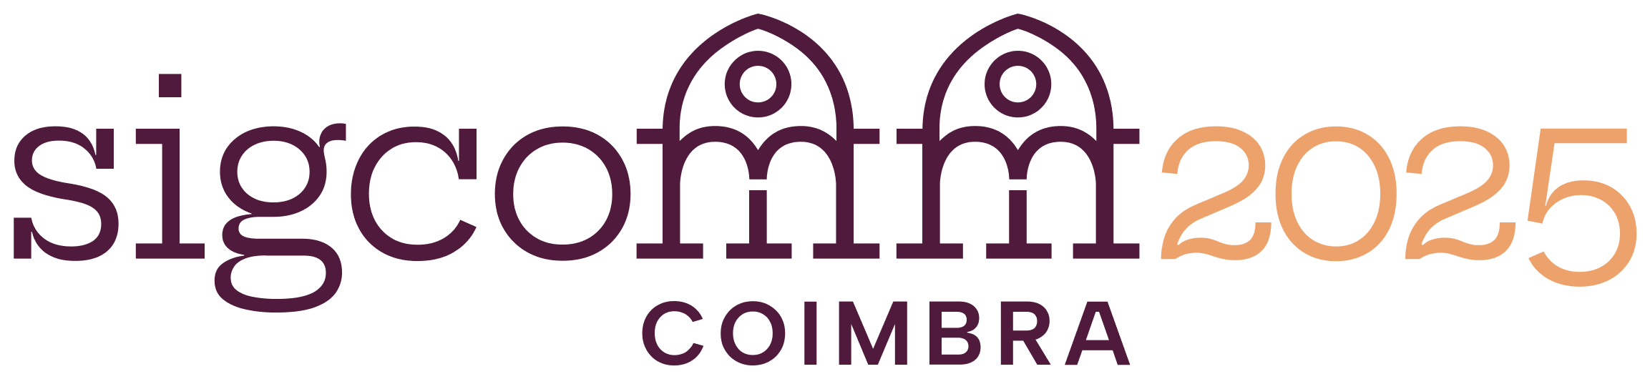




SkeletonHunter: Diagnosing and Localizing Network Failures in Containerized Large Model Training
Wei Liu , Kun Qian, Zhenhua Li, Tianyin Xu, Yunhao Liu, Weicheng Wang,
Yun Zhang, Jiakang Li, Shuhong Zhu, Xue Li, Hongfei Xu, Fei Feng, Ennan Zhai
Notes:
OK, thanks for the introduction. Good morning, everyone. Today, I’m going to present our work: SkeletonHunter, a system designed to diagnose and localize network failures in containerized large model training. This is joint work with colleagues from Tsinghua University, Alibaba Cloud, and UIUC.

Slide 2
Outline
Background
Motivation
Design
Evaluation
Conclusion

Slide 3
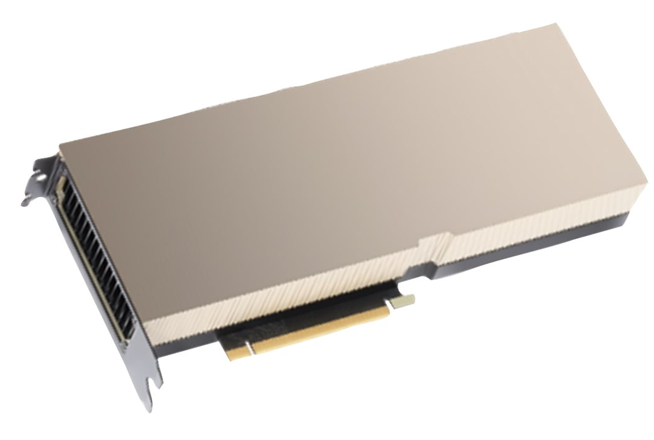
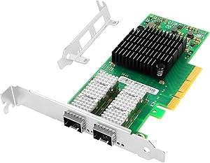


1. Background
Large model training is an important business for CSPs
  Large models are typically trained with
    Significant infrastructure support
    Hundreds of thousands of GPUs
    Several weeks
O(1000)× High-end GPU
O(1000)×RDMA NIC (RNIC)
High-Speed, Reliable Interconnections
Notes:
Large model training is emerging as an important business for cloud service providers (or CSPs for short).
This is because the training process of today’s large models always requires massive computing and networking resources, and thus significant cloud infrastructure supports.
For example, training large models like GPT-3 or Llama-3 involves hundreds to thousands of GPUs, lasting for weeks to months.
Large model training has become a cornerstone of modern AI services. Training models like GPT-3 or Llama-3 requires massive computational resources—often hundreds of thousands of GPUs running continuously for weeks or even months. This scale demands high-speed, low-latency networks, typically built on RDMA over Converged Ethernet (RoCE), where round-trip times must be under 20 microseconds to avoid slowing down training. At Alibaba Cloud, we support such workloads with over 40,000 RNICs and GPUs, serving millions of training tasks.

Slide 4
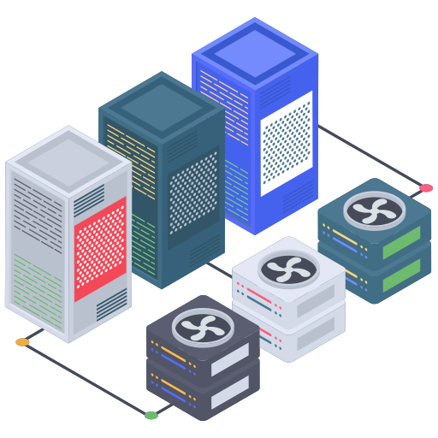

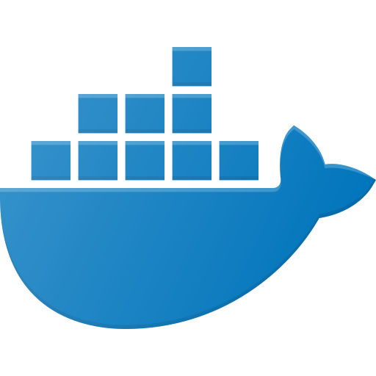
1. Background
Large model training is an important business for CSPs
  Large model training can mainly be launched by
Physical clusters
Container clusters
    Highly customizable, but…
    Requires professional experiences
    Not flexible enough
    High operational cost
    High flexibility
    Easy to use
    Cost-efficient (on demand)
Notes:
To train a large model, users can launch a training task through either physical clusters or container clusters.
While a physical cluster is highly customizable for users, it requires the users to have professional experiences on configuring and coordinating the machines, GPUs, and RNICs.
Also, it is not flexible enough on scaling, and always incurs high operational cost.
In contrast, containerized large model training has now become popular given its lightweight and high flexibility.
Users can launch training tasks with different numbers of GPUs and RNICs on demand.
In this way, it is more cost-efficient and widely used by common users.
Users can launch training jobs on either physical clusters or containerized environments. Physical clusters offer high customizability but require deep expertise and lack elasticity. Containerized training, on the other hand, provides flexibility, ease of use, and cost efficiency. As a result, it has become the preferred choice for many users. Our cloud platform hosts a multi-tenant training environment that has served over 5 million containerized training tasks in the past three years.

Slide 5
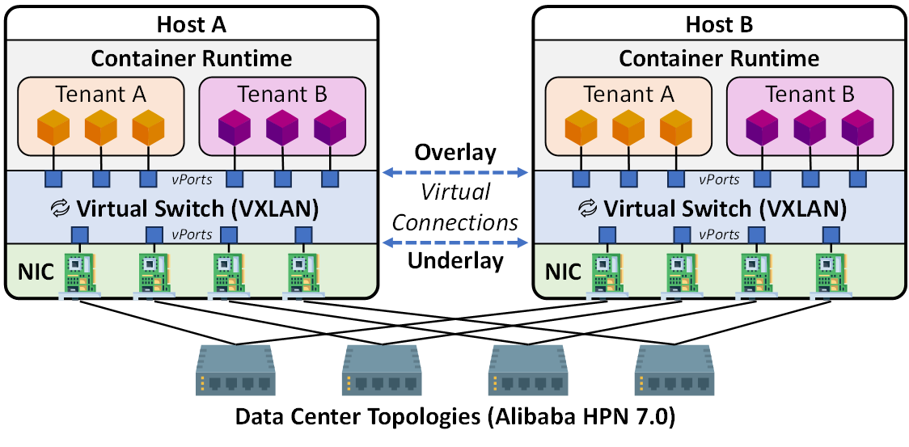
1. Background
As a major CSP, we have…
  A large-scale, multi-tenant large model training cloud
  40K+ RNICs, and 40K+ GPUs
  Operating over 3 years
  Serving 5M+ large model training tasks from users
Notes:
As a major CSP, we have been operating a large-scale multi-tenant large model training cloud for over three years.
It is equipped with forty thousand RNICs and forty thousand GPUs, and has served over 5 million large model training tasks from users.
As you can see, the architecture of our containerized model training infrastructure is based on overlay networks, where containers can be created and allocated with RNICs and GPUs elastically.
Our underlay network is based on Alibaba HPN, which is specially optimized for AI workloads.
The reliability of containerized training is crucial. Training is highly synchronized—each step must complete within a tight latency bound. Even a small delay can slow down the entire process, and a failure can cause financial loss. However, pinpointing network issues is challenging due to container dynamics, endpoint complexity, and overlay-underlay interplay.

Slide 6
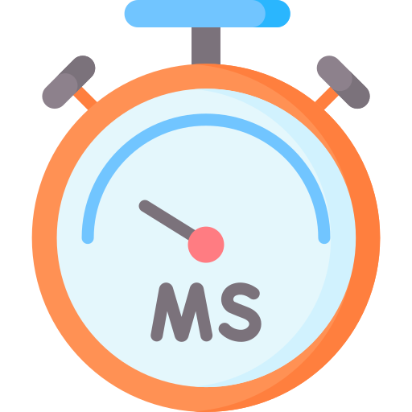




2. Motivation
The reliability of containerized model training is crucial
  Training nodes’ GPUs are inter-connected
  Low-latency, high-bandwidth networks
  Training process is highly synchronized
  Sensitive to single-point network failure
RTT <20 us
Throughput >200 Gbps
Financial loss to customers
Sync
Sync
…
Sync
Step 1
Step 2
Step n
Notes:
Under such a large scale, reliable networking is crucial for service quality, particularly the connectivity among the training nodes.
This is because the training nodes’ GPUs should be connected under a low-latency, high-bandwidth networks, either intra-host or inter-host networks, for high-performance training data exchanging.
Also, large model training is highly synchronized. Each training step requires all workers to exchange gradients simultaneously. Even a minor network issue—like a 1-milisecond latency increase—can slow down training by 20%.
A failure lasting more than 4 seconds can cause the entire job to fail, and finally cause substantial financial loss to customers.

Slide 7
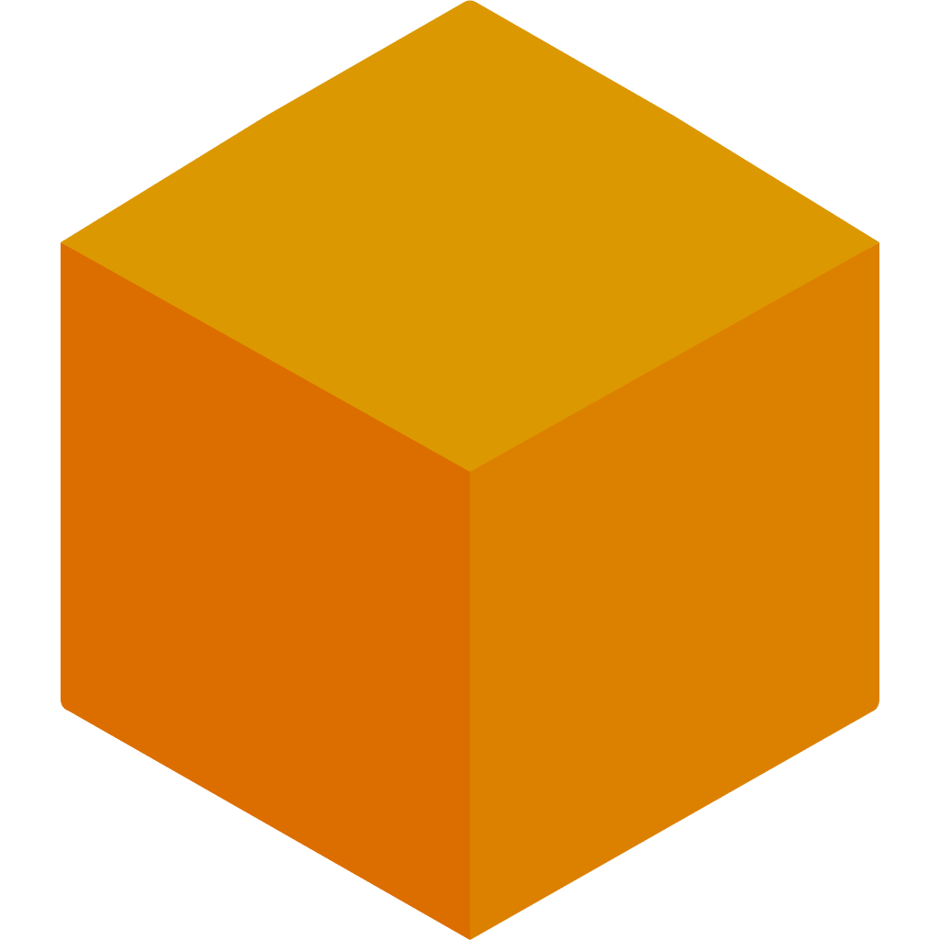
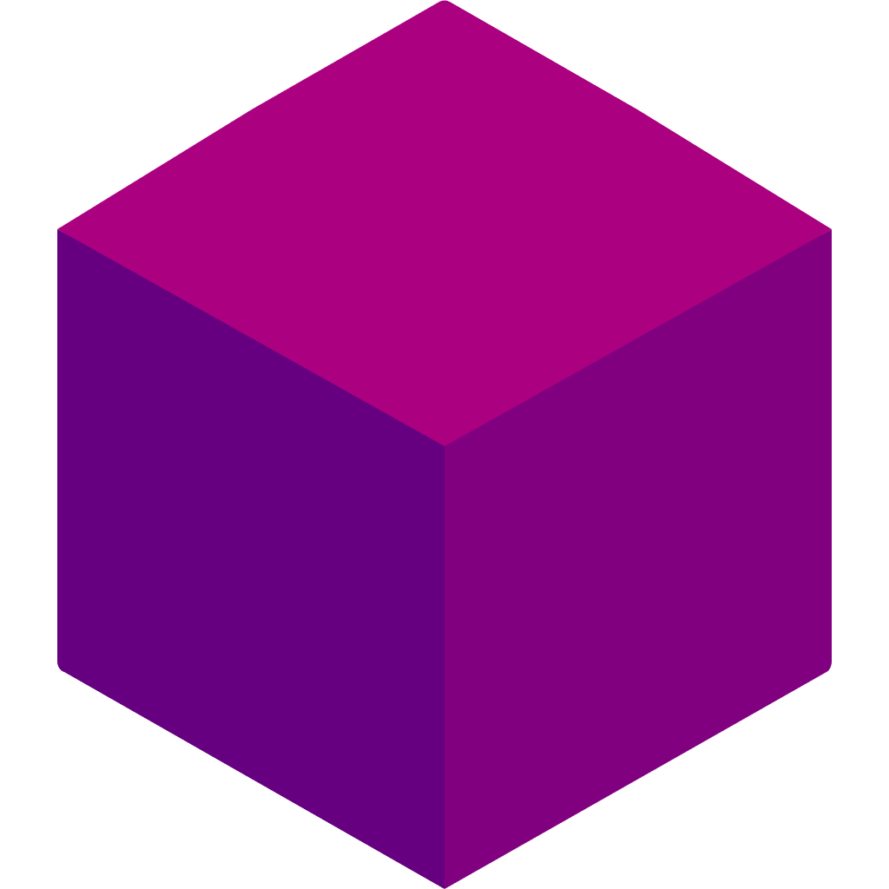


2. Motivation
Pinpointing network connectivity issues is not easy
  High dynamics of containers
  Endpoint-induced complexity
  Interplay between overlay and underlay networks
Init/Creating
Running
Completed/Crash
Training Containers
Host RNICs
Overlay
vPorts
Virtual Switch Flow Tables
Flow Offloading
vPorts
Underlay Flow Tables
Notes:
Unfortunately, pinpointing network connectivity issues is not an easy job in containerized large model training scenario.
This is just like pinpointing network issues in traditional data centers is not easy, while model training workloads further adds to the difficulty.
The difficulty comes from three-fold reasons based on our operational experiences.
They’re high dynamics of containers, endpoint-induced complexity, and the interplay between overlay and underlay networks.

Slide 8
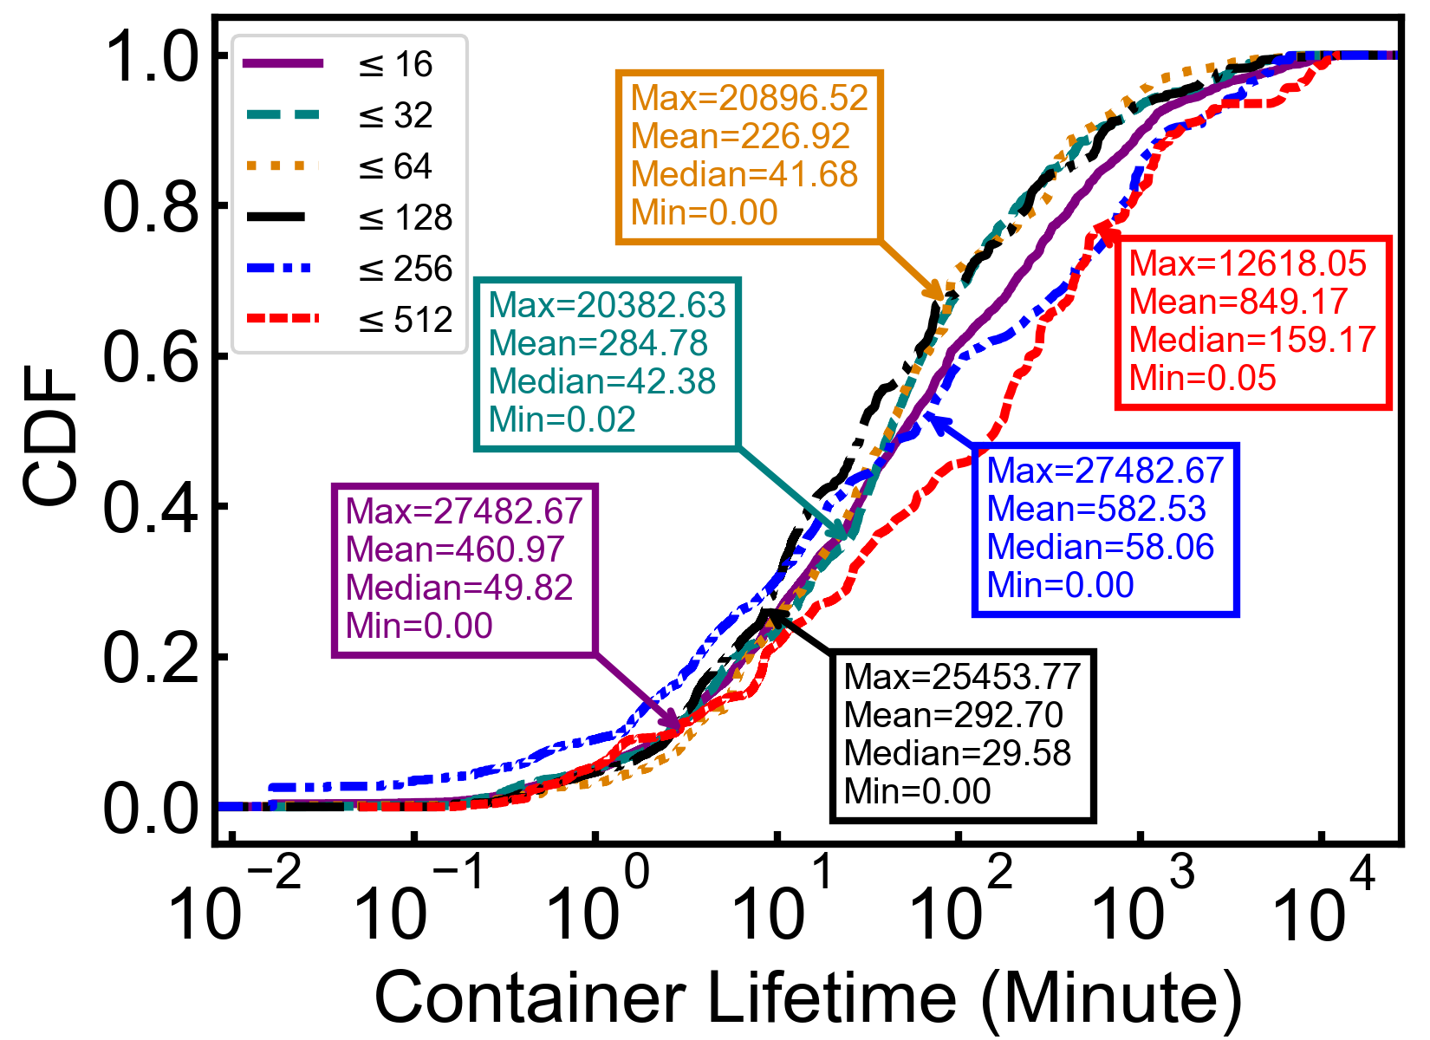
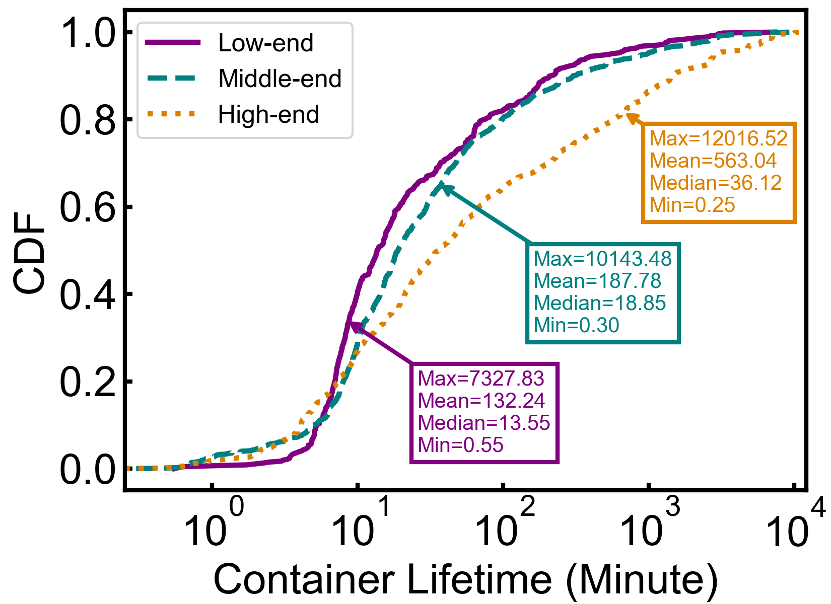
2. Motivation
High dynamics of containers
  Over 50% of training containers have a lifetime of less than 60 minutes
  Containers with higher-end configurations have a longer lifetime
Notes:
Let me explain in detail. First, containers are highly dynamic. Our production data show that over 50% of training containers live for less than sixty minutes, while containers with a higher-end configurations have a longer lifetime.
This is easy to understand because containers with lower-end hardware configurations are usually used for debugging or testing during the training process, which are more likely to be short-lived. After the debugging or testing, users will use higher-end containers for actual training tasks.

Slide 9
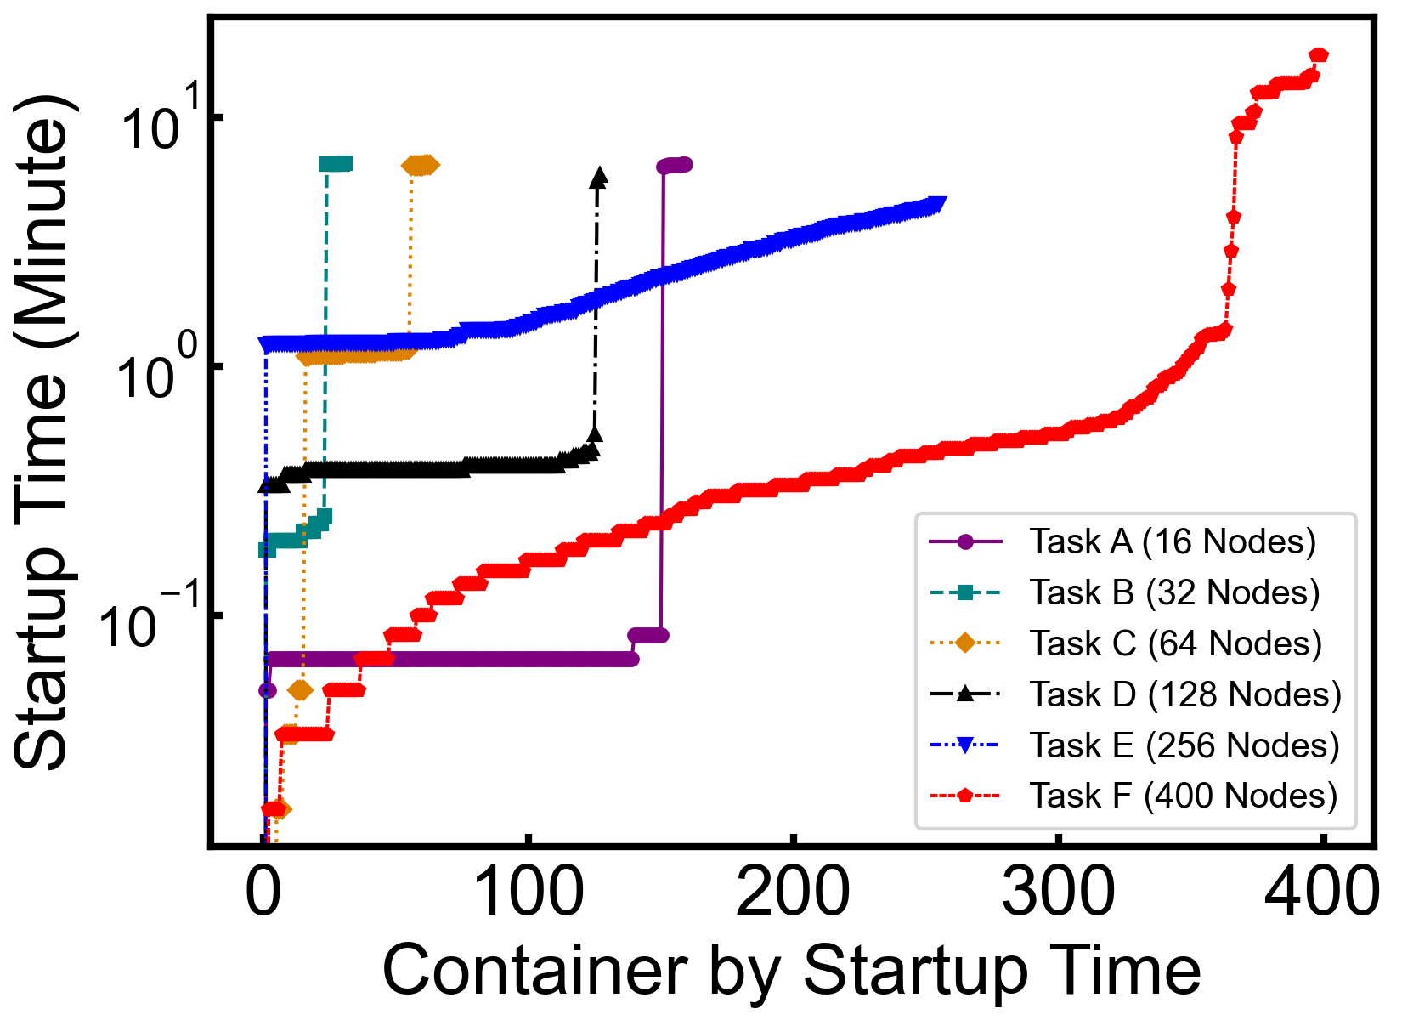
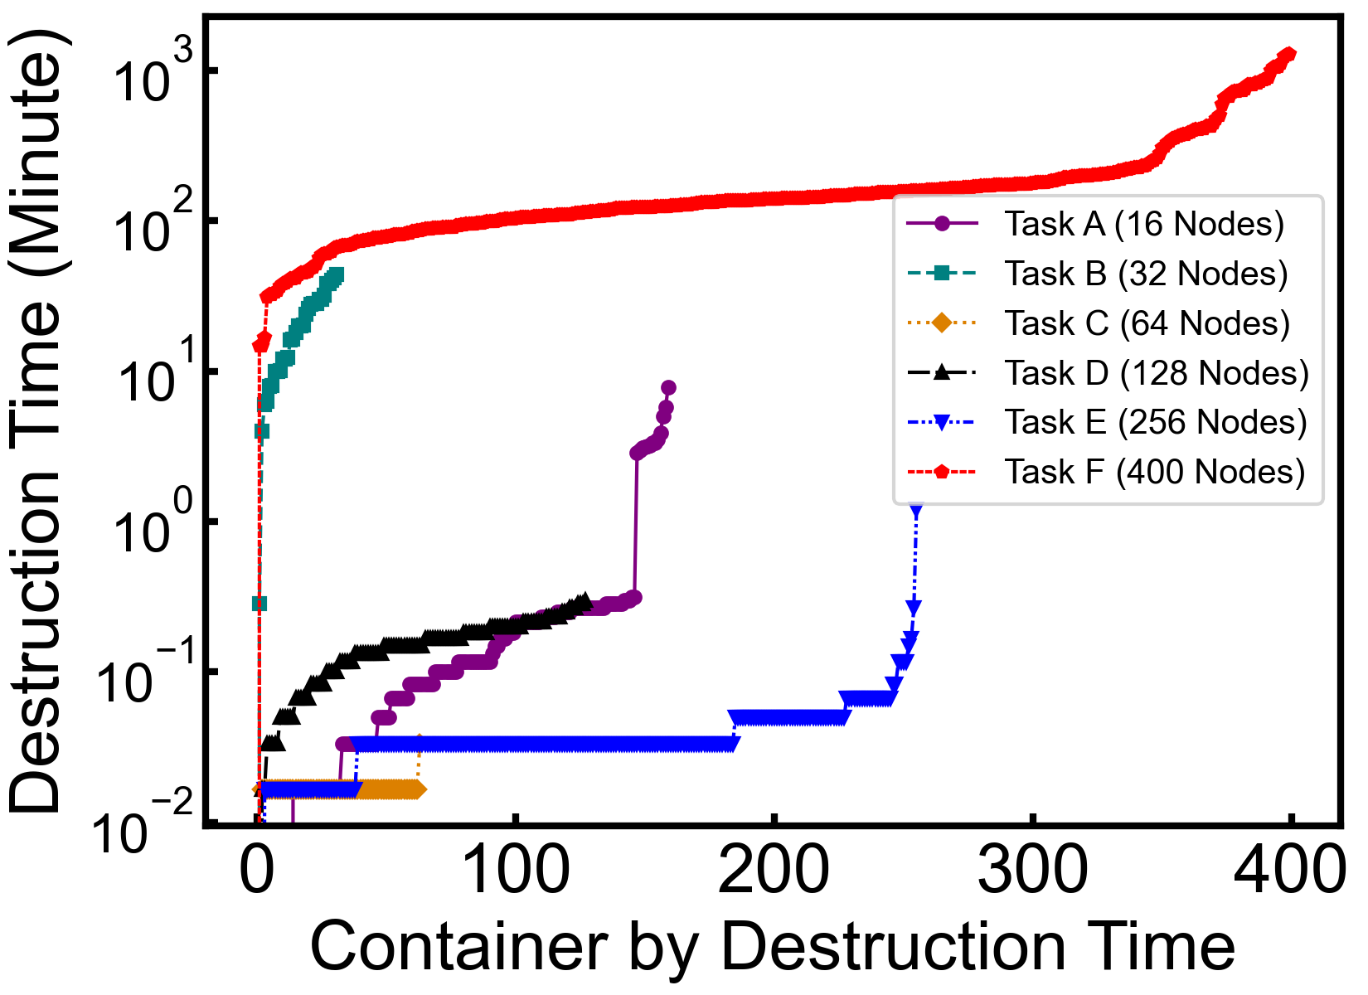
2. Motivation
High dynamics of containers
  Containers in the same training task suffers minute-level time lag in state synchronizations
  The longest time lag reaches 10 minutes
Challenge 1
Requiring fast connectivity probing on the highly dynamic network topologies
Notes:
We also notice that even containers within the same training task can start up minutes apart due to resource scheduling delays in different hosts.
And the longest delay can last for 10 minutes.
All the above container dynamics make the network topology changes frequently, making it difficult to keep continuous monitoring.
This is the Challenge 1: we need fast probing mechanisms on such dynamic network topologies.

Slide 10
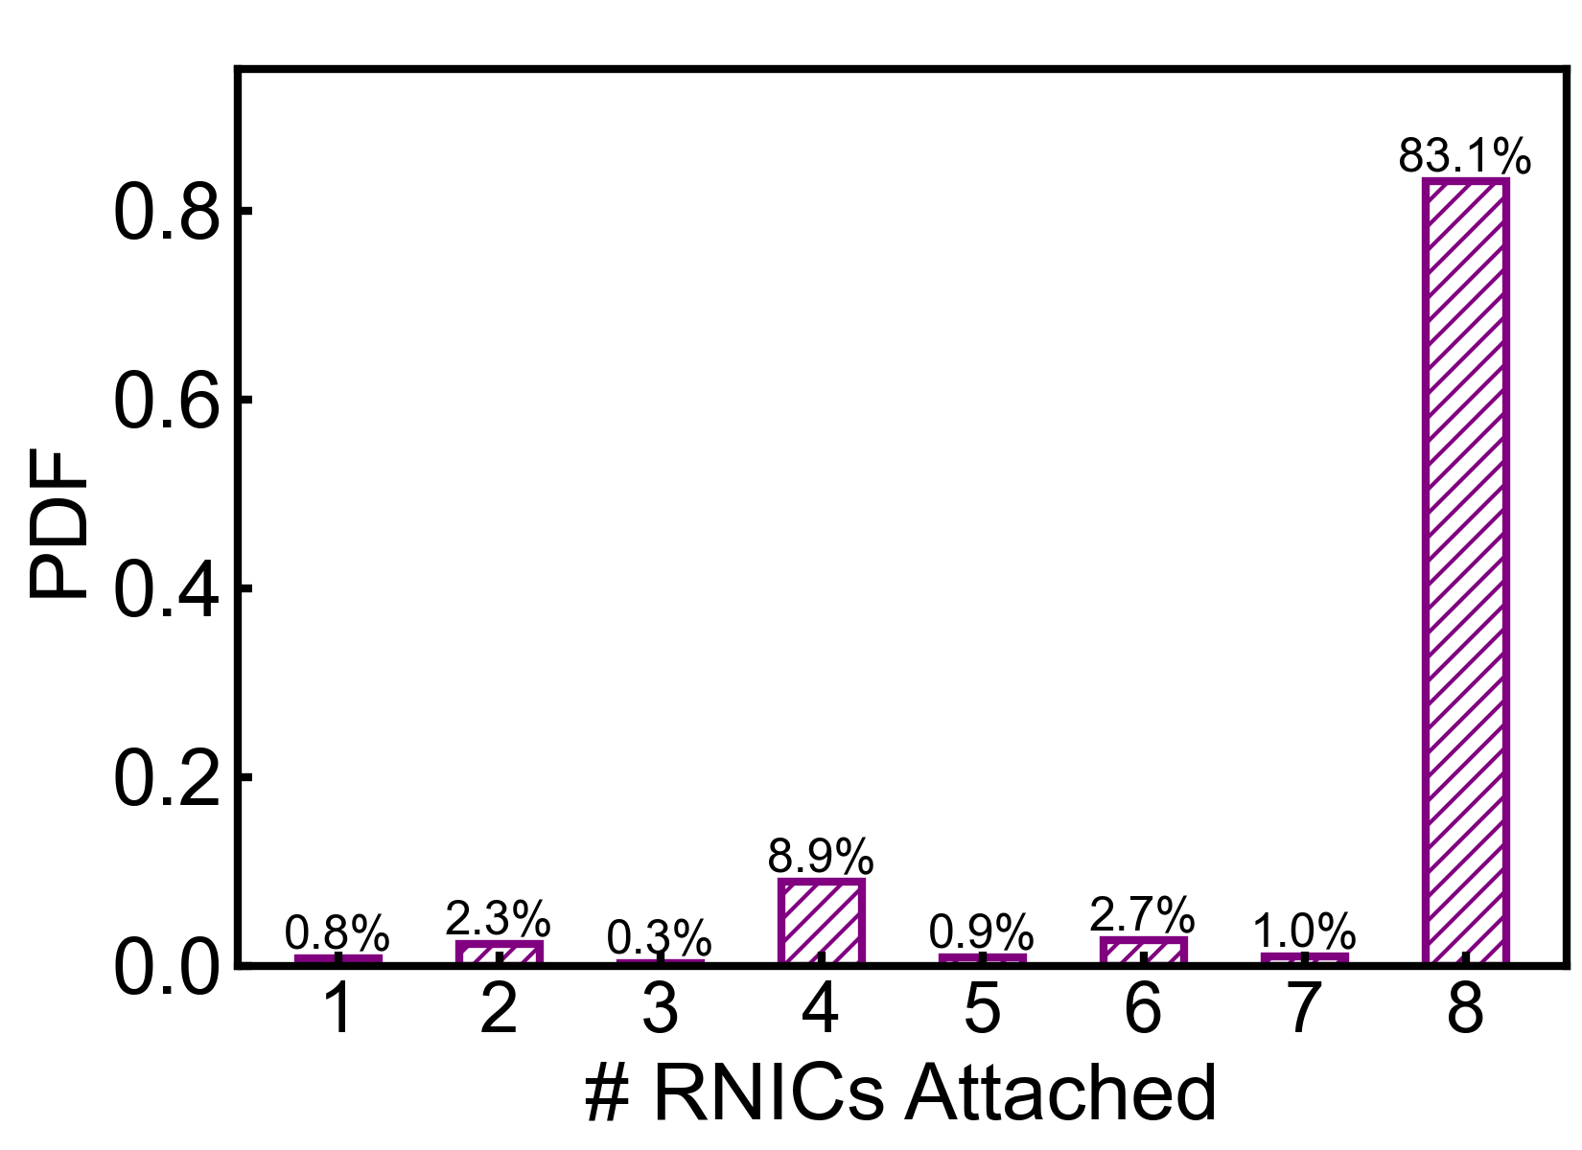
2. Motivation
Endpoint-induced complexity
  A training container can bind to multiple (e.g., eight) RNICs (endpoints)
  Adapting to different parallelism patterns
  Each endpoint pair should be covered for connectivity monitoring
Challenge 2
Requiring efficient coverage of the endpoint-induced complexity
Notes:
The second challenge is the endpoint-induced complexity. Each container can bind to multiple RNIC endpoints—often eight—to support different parallelism strategies like tensor parallelisms and pipeline parallelisms. This also adds to the complexity of connectivity monitoring.

Slide 11
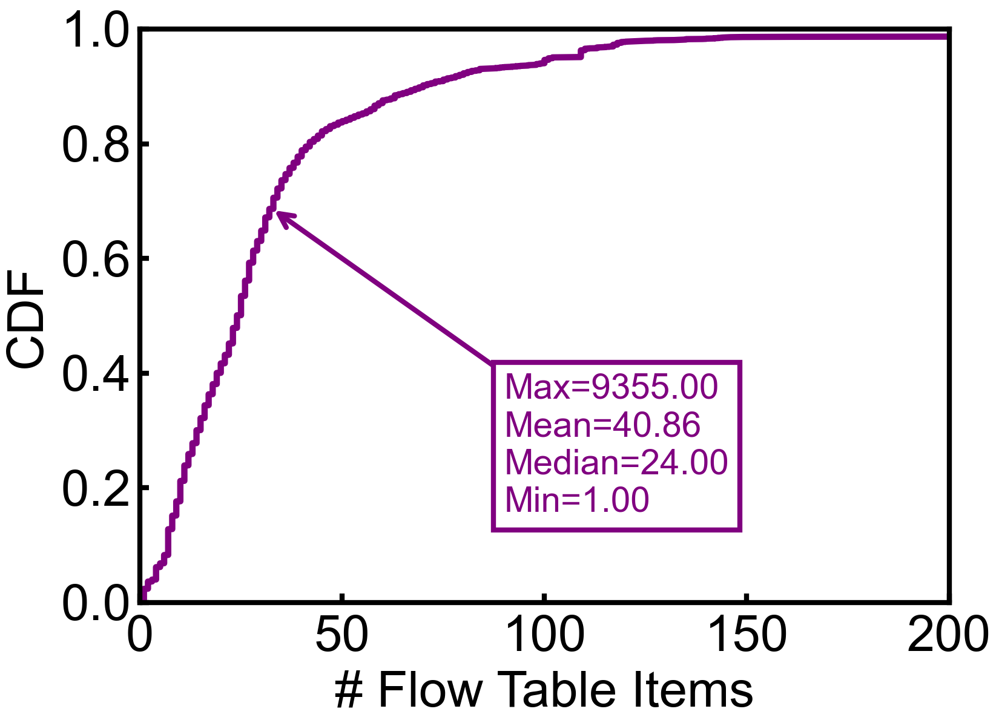
2. Motivation
Interplay between overlay and underlay networks
  Multi-tenant support through overlay networks
  SRIOV+eSwitch to offload overlay traffic to physical RNICs
  Virtual switch to determine traffic switching in data plane
  40 flow table items on average, 9.3K max on each host
Challenge 3
Requiring effective disentanglement of the overlay-underlay interplay
Notes:
And thirdly, to support multi-tenancy, we use overlay networks like VXLAN on top of the physical underlay. This introduces virtual switches, flow tables, and SR-IOV virtual functions. On average, each host has forty flow table entries, and some can have over nine thousand. This complexity makes it hard to isolate whether a failure is in the overlay or underlay. So the Challenge 3 is disentangling this interplay between the overlay and the underlay networks for failure localization.

Slide 12
2. Motivation
Multiplicative effect of the complexity
  X containers
  Y RNICs for each container
  Z virtual network components for each RNIC
  Examining X×Y×Z network components in each training round!
  e.g., 1K×8 ×16=128K
Notes:
And what is even worse is that, these challenges form a multiplicative effect of the complexity in connectivity monitoring among training containers.
Suppose we have X containers, each container has bound to Y RNICs, and each RNIC corresponds to Z virtual network components like flow tables.
Then, the total number of network components to be examined in each training round is X times Y times Z.
For a training job with one thousand containers, each with 8 RNICs, and each RNIC corresponds to sixteen virtual components, we must monitor over one hundred and twenty-eight thousand network components per training round in about 20 seconds . This is not feasible for traditional monitoring tools.

Slide 13
2. Motivation
Opportunity——Sparse spatial traffic distributions
  Training data are only exchanged cross the GPUs with dependencies
  Derived from various parallelism strategies
PP=1
PP=2
…
PP=8
PP=1
PP=2
…
PP=8
TP=1
TP=2
…
…
DP=8
TP=8
DP=2
DP=1
Notes:
To address the above challenges, we performed an in-depth study into the training traffic, and finds two opportunities to effectively reduce the complexity of the connectivity monitoring.
First, training traffic has a sparse spatial distributions since training data are only exchanged across GPUs with data dependencies.
This is derived from the various parallelism strategies used in large model training.
For example, a large model can be split into multiple GPUs to avoid the model size exceeds the capacity of a single GPU.
This is called tensor parallelism (or TP for short).
Then, different layers of a model can be split into multiple hosts to enable pipelined training, which is call pipeline parallelism (or PP) for short.
Similarly, we can divide the input data into multiple batches to enable concurrent training. This is called data parallelism (or DP for short).
After training iteration, different DP groups will exchange the parameter values to synchronize the gradients.

Slide 14
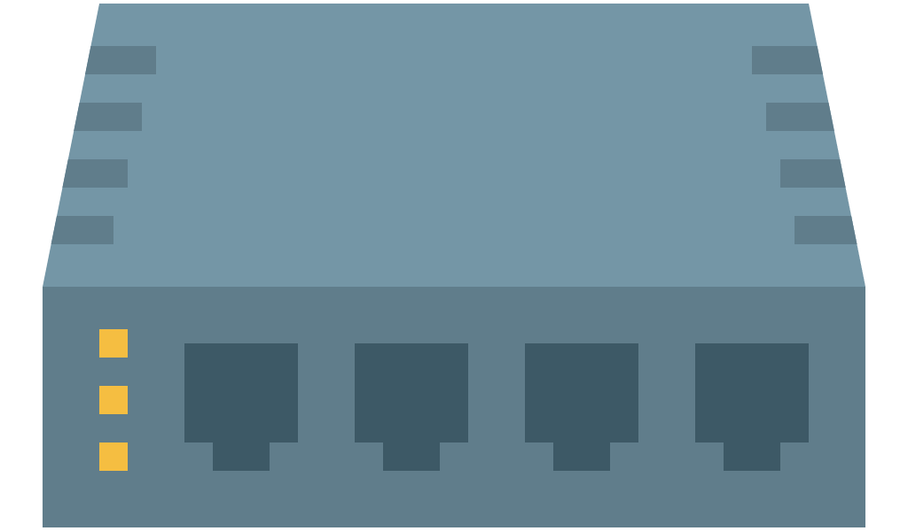
2. Motivation
Opportunity——Sparse spatial traffic distributions
  Rail-optimized data center topologies
  Widely used collective communication libraries like NCCL and MPI
GPU1@Host A
GPU2@Host B
Host A
Host B
NVLink
⊗
NVLink
⊗
GPU
1
2
3
4
GPU
1
2
3
4
PCIe
PCIe
RNIC
1
2
3
4
RNIC
1
2
3
4
Physical Switches (Data Center Topologies)
Notes:
Furthermore, today’s rail-optimized datacenter topologies for AI workloads like HPN in Alibaba also result in a sparse traffic distributions.
Any intra-host cross-rail communications will be transformed to intra-host communications in the same rail.
So actually, the network connectivity only happens at the same rank of RNICs across different hosts.

Slide 15
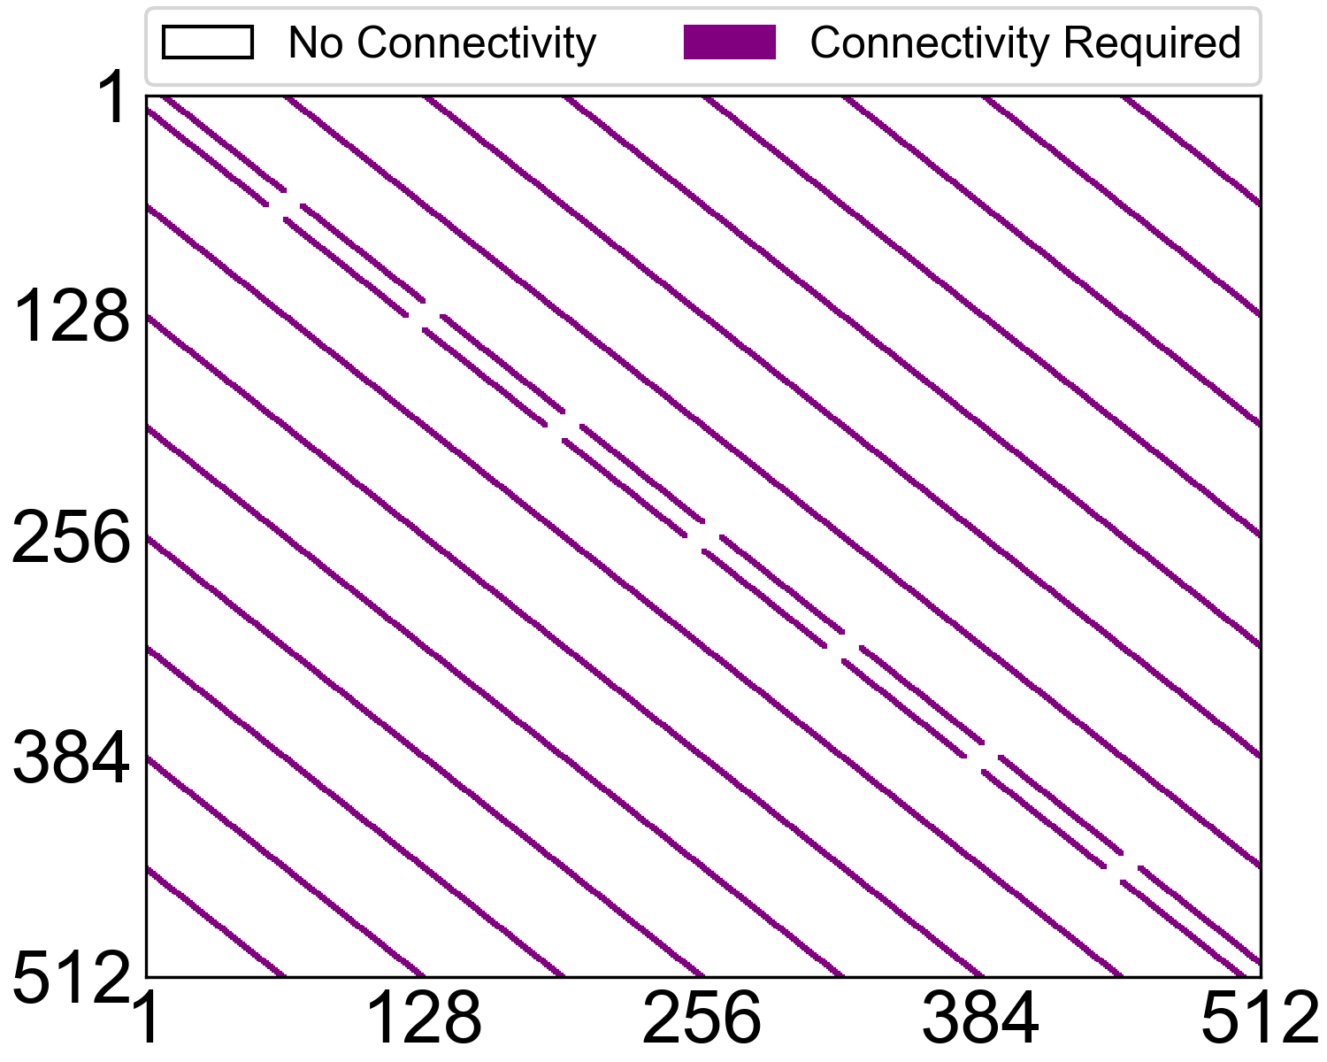
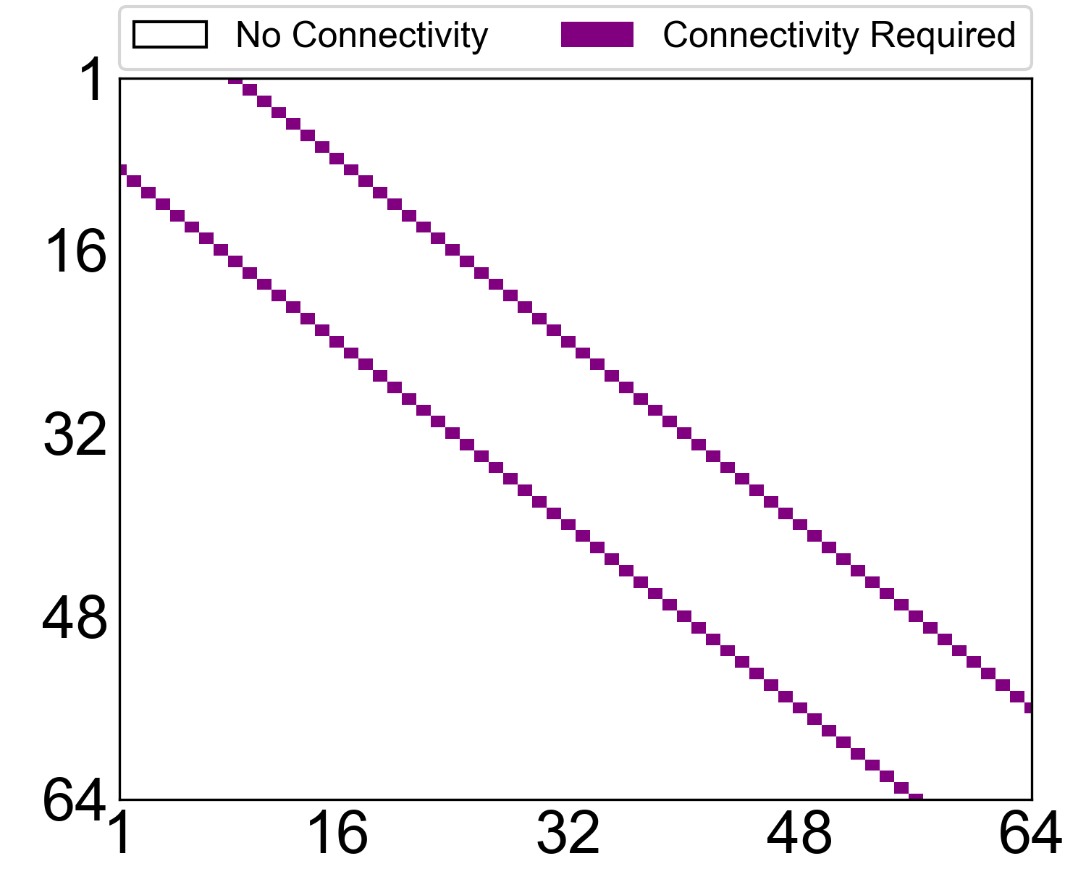
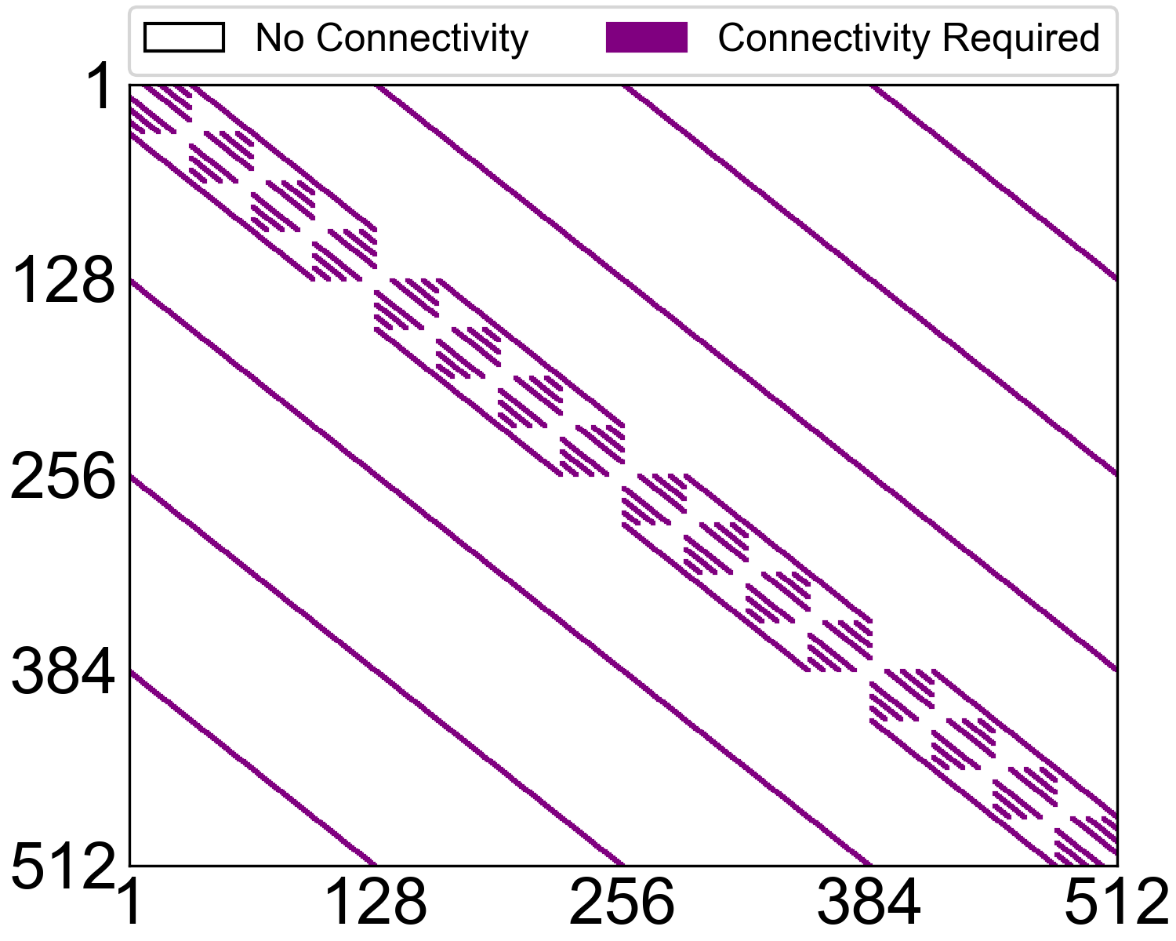
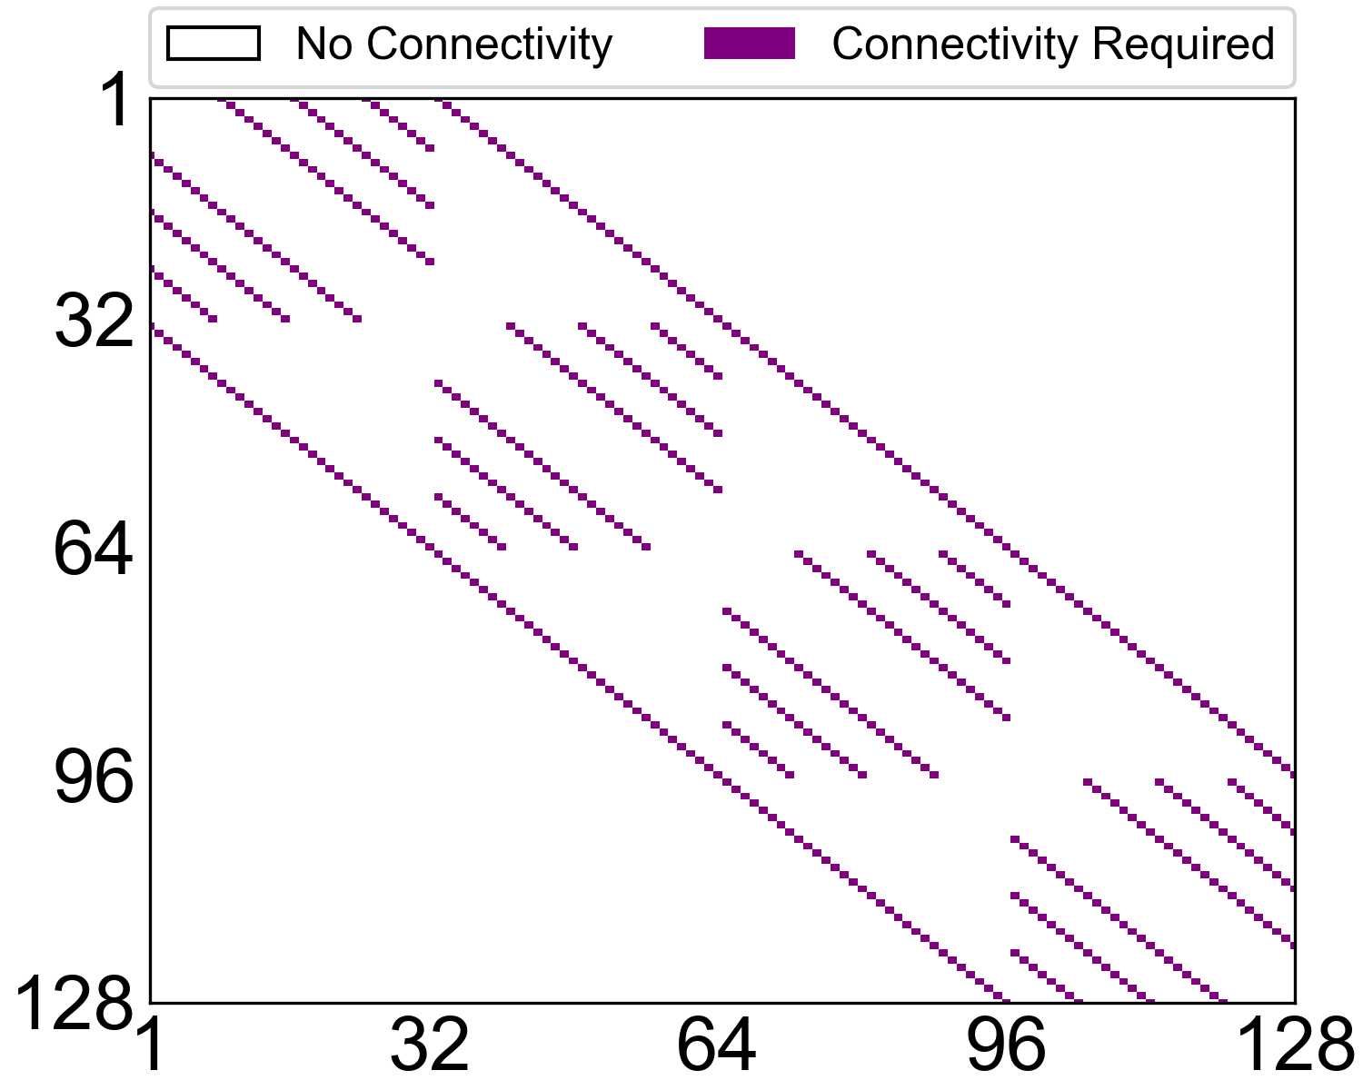
2. Motivation
Opportunity——Sparse spatial traffic distributions
  Traffic matrix of model training
Dense Model
A single DP level
MoE Model
Notes:
The above parallelism strategies and data center topologies form a unique traffic distribution.
Here we show the traffic matrix of the RNICs for different models.
We can see that most GPUs and the corresponding RNICs do not require connections, and each DP level presents repeated connection patterns.

Slide 16
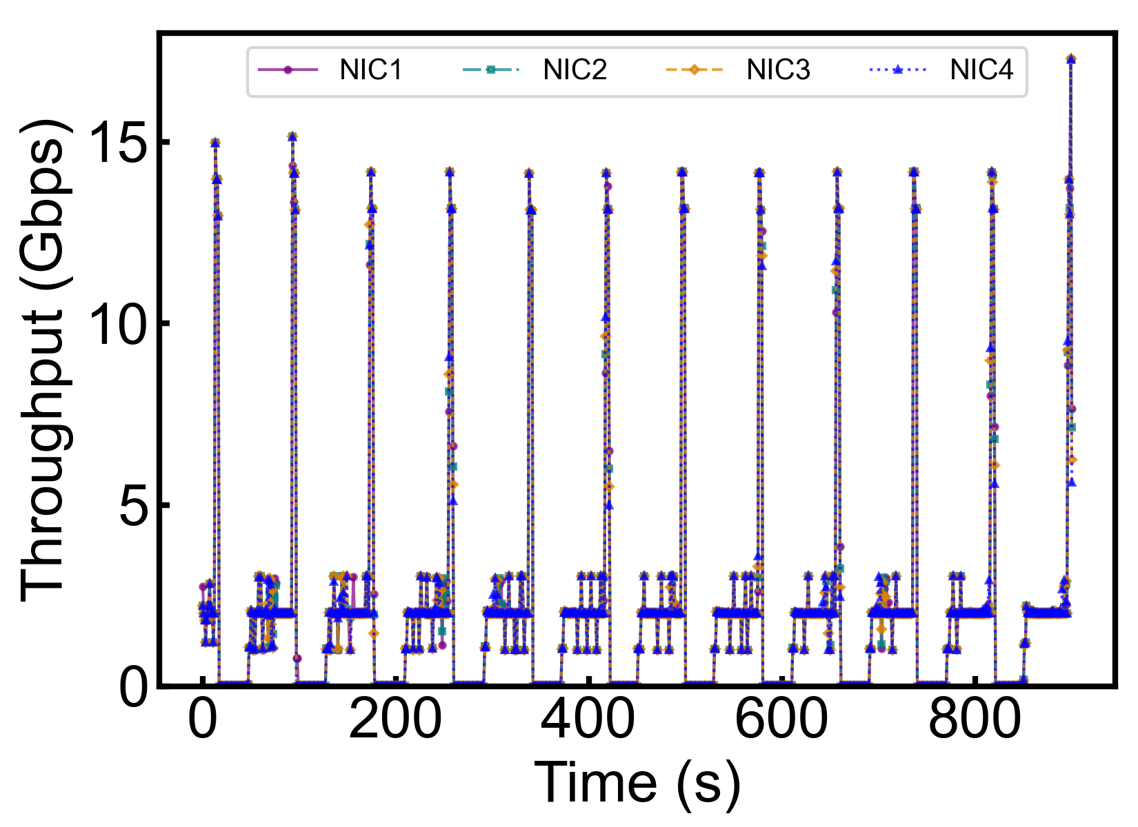
2. Motivation
Opportunity——Temporal burst cycles
  Periodic and seasonal patterns
  Provide the opportunity to distinguish the “role” of each container in model parallelisms
Notes:
Apart from the temporal feature, training traffic is also periodic in the time domain.
We notice that each training iteration ends with a burst of gradient synchronization, followed by idle periods as shown in the figure.
These spatial and temporal characteristics of the training traffic all guide us to distinguish the “role” of the RNICs of each containers, so that we can optimize the connectivity probing process.

Slide 17
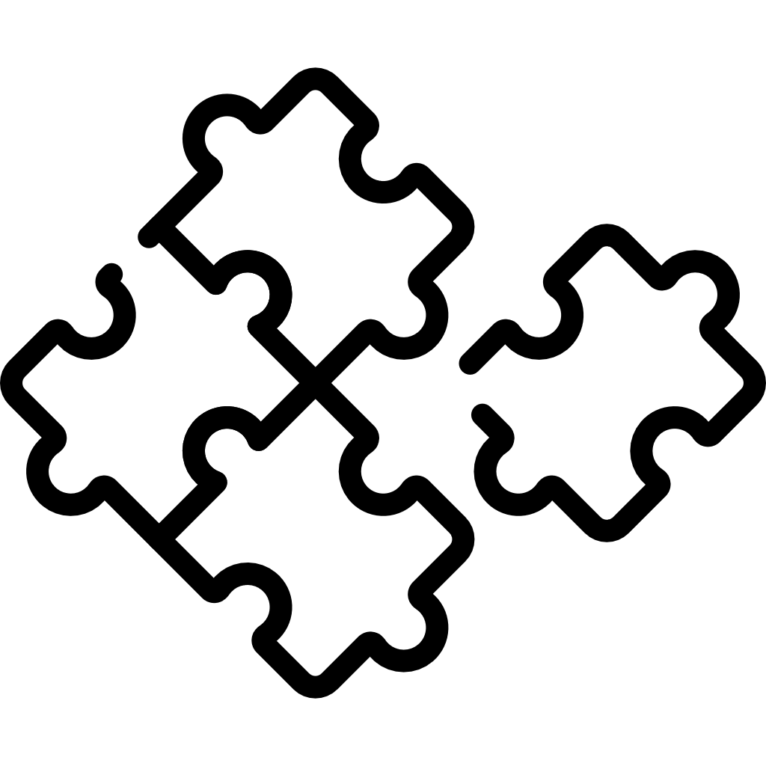
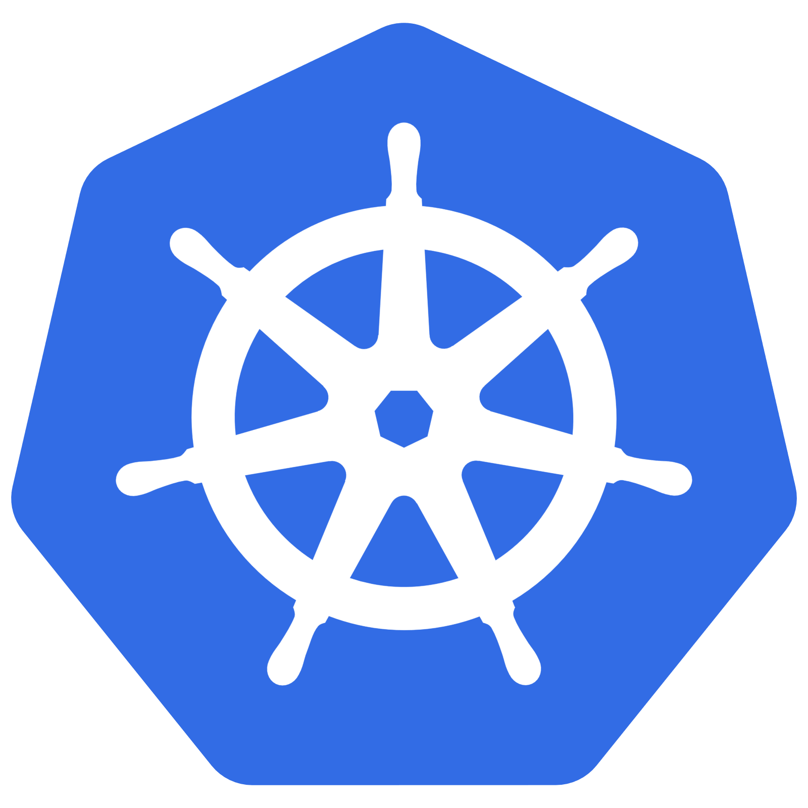
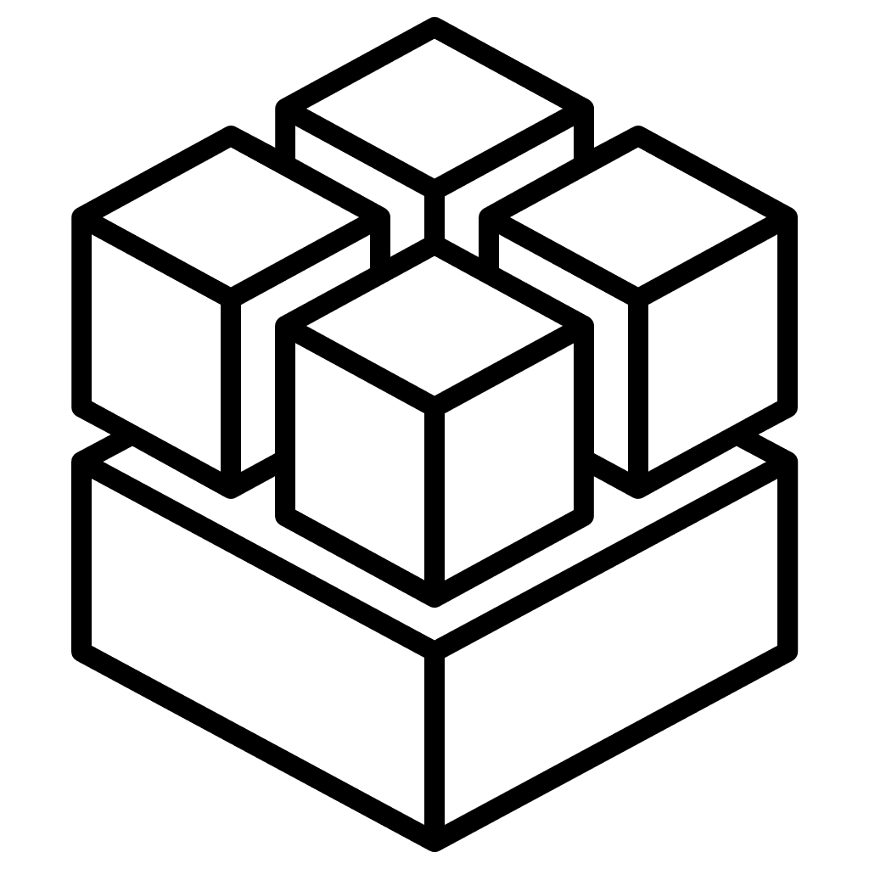
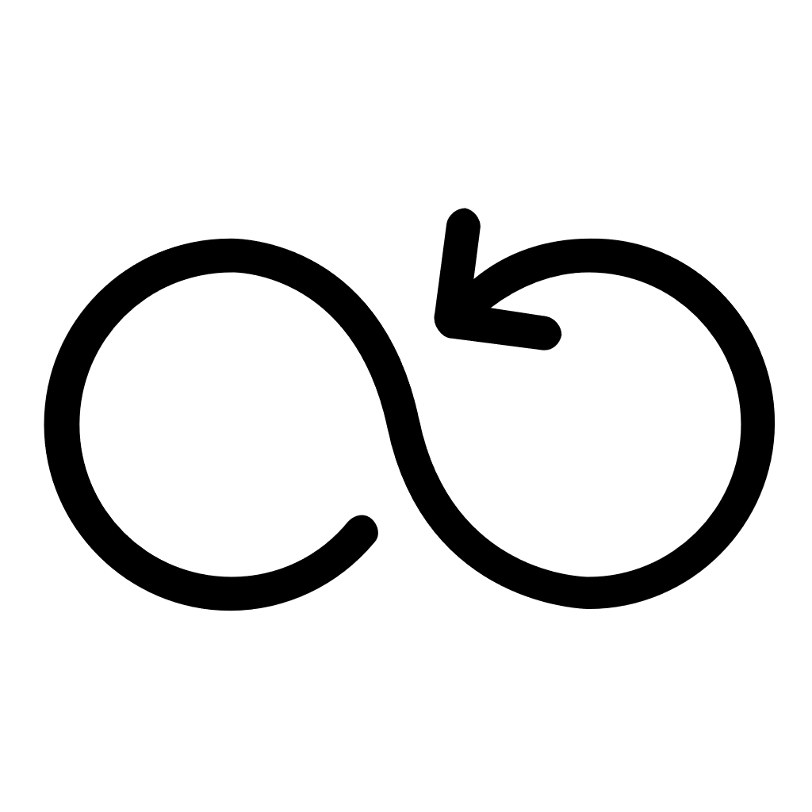

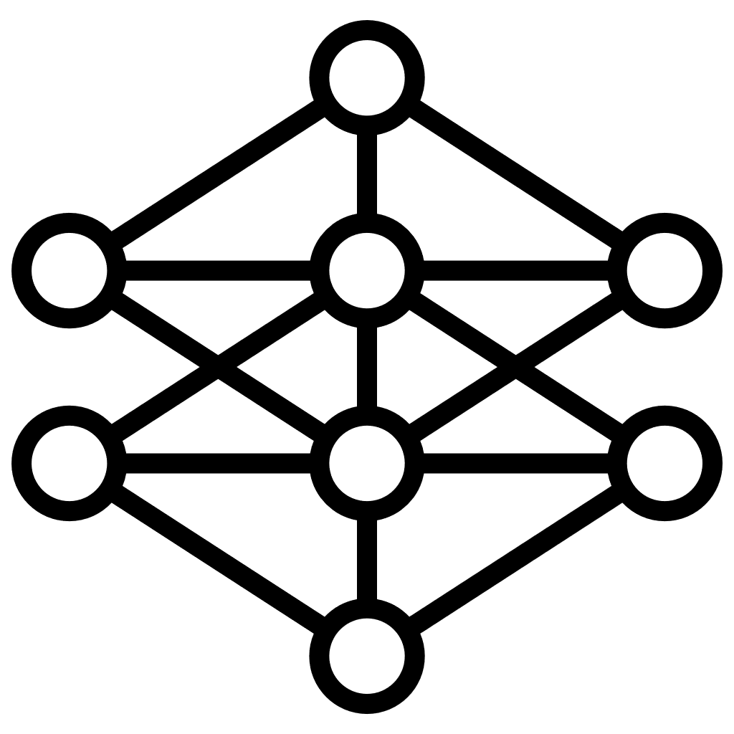

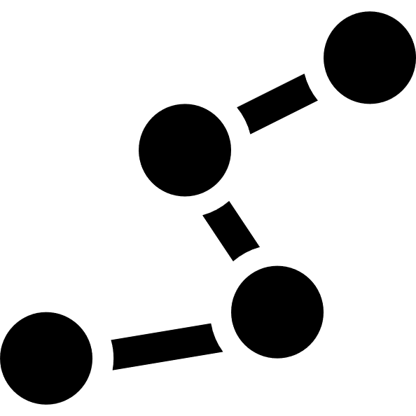
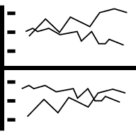
3. Design of SkeletonHunter
Architectural overview
  Key idea——Infer traffic skeletons to reduce the monitoring complexity
Controller
Suspicious
Components
Analyzer
Skeleton-Optimized
Ping List Generation
Overlay-Underlay
Disentanglement
Traffic
Skeletons
Control-Plane
Cluster Info
Network
Issues
Underlay
Instructions
Overlay
Ping List
Frontend Network
Traffic Skeleton
Inference
Anomaly
Detection
Overlay Containers
Physical
Hosts
Ping List
Activation
Physical
Hosts
…
Network Virtualization
…
Underlay Agent
Host
Backend Network
Notes:
So we present SkeletonHunter, a system that enables efficient and accurate detection of network issues for our in-production containerized model training services.
Our key idea is to infer the traffic skeletons, which are composed of a crucial set of network paths consistently traversed in large model training, to reduce the monitoring complexity.
SkeletonHunter is inspired by Pingmesh but tailored for training workloads. It consists of three components: a controller that generates ping lists, agents deployed on each host that perform probing, and an analyzer that detects anomalies and updates the traffic skeletons.

Slide 18
3. Design of SkeletonHunter
Traffic skeleton inference
  Preload: Remove ping list that are not in the same rail
  Initialization: Incremental ping list activation
Host A
Host B
NVLink
⊗
NVLink
⊗
GPU
1
2
3
4
GPU
1
2
3
4
7/8 reduction in ping list size
PCIe
PCIe
RNIC
1
2
3
4
RNIC
1
2
3
4
Created
Running
Ping List Register
Notes:
To infer the traffic skeletons, the generation of the ping list for each container is in a phased manner.
During the preloading phase, we remove ping targets in an all-to-all ping list that are not in the same network rail, which reduces the scale of ping list to one eighth of the all-to-all ping list.
The next phase is the initialization phase, which aims to mitigate the probable false probings due to different startup time of containers.
To this end, after receiving the ping list from the controller, the agent on each container does not ping the others until some other containers register themselves after their creation.
In this way, we minimize the false alarms on the connectivity issues among the containers that have not been created in the same training task.

Slide 19
3. Design of SkeletonHunter
Traffic skeleton inference
  Runtime: Optimization with inferred traffic skeletons
B
A
D
C
RNICs in the same rank position across different DPs have the same burst patterns in traffic
Notes:
At runtime, we further minimize the ping targets with the inferred traffic skeletons.
Our key observation is that RNICs in the same rank position across different DPs have the same burst patterns in traffic.
For example, the traffic bursts of RNICs A and B are similar, and RNICs C and D are also similar, since they are in the same rank position of different DPs.

Slide 20
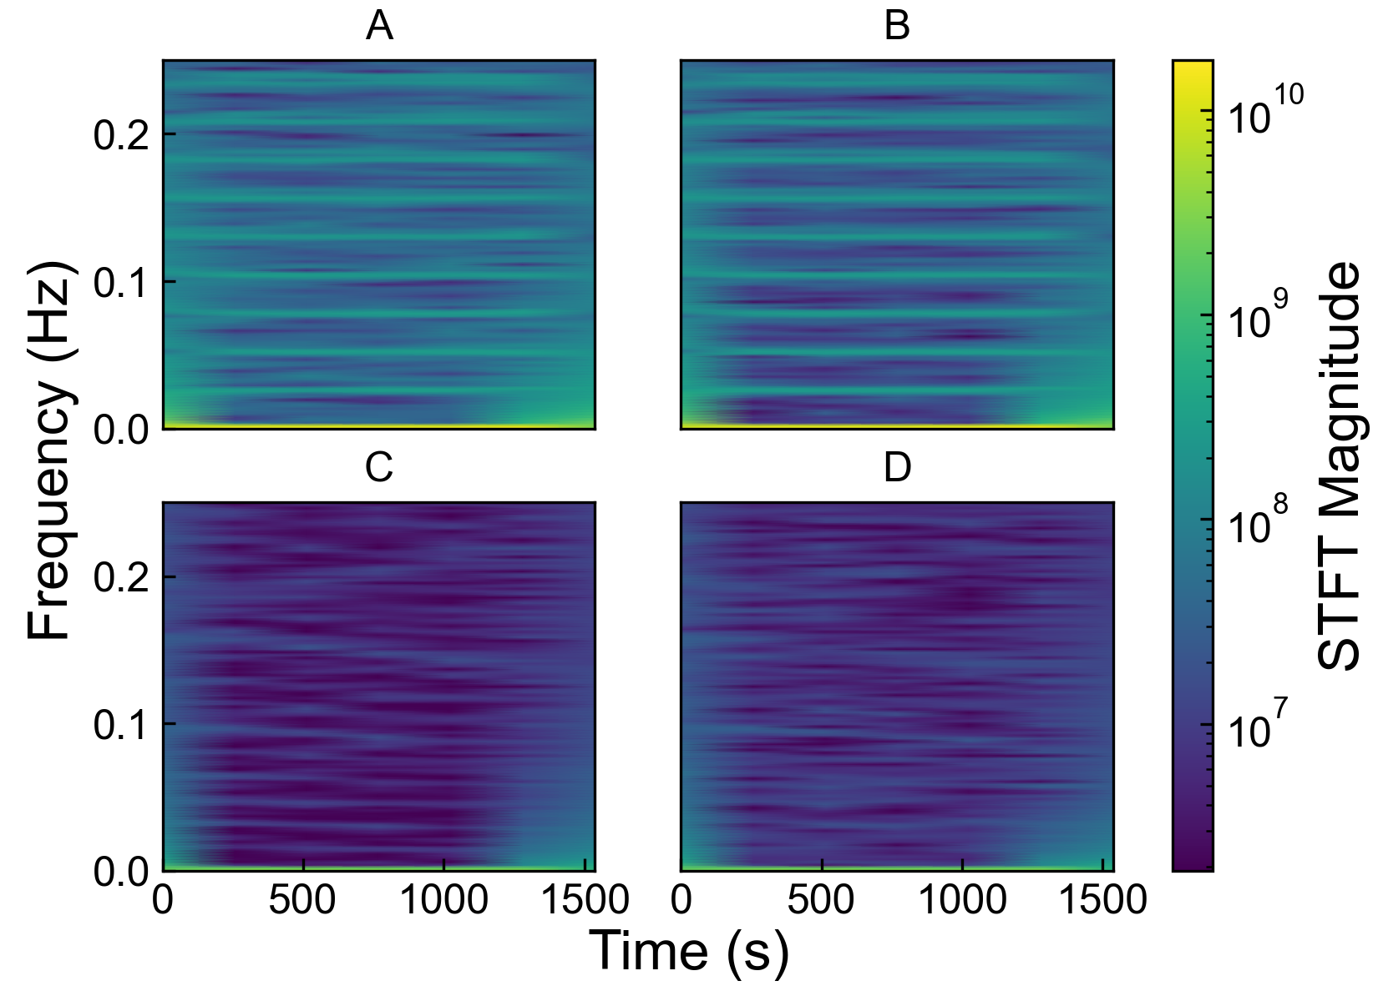
3. Design of SkeletonHunter
Traffic skeleton inference
  Runtime: Optimization with inferred traffic skeletons
Cluster RNICs with similar
STFT patterns
Notes:
We use Short-Time Fourier Transform (STFT) to extract frequency features from traffic bursts for each RNIC. Then, we cluster RNICs with similar patterns to infer the DP groups.

Slide 21
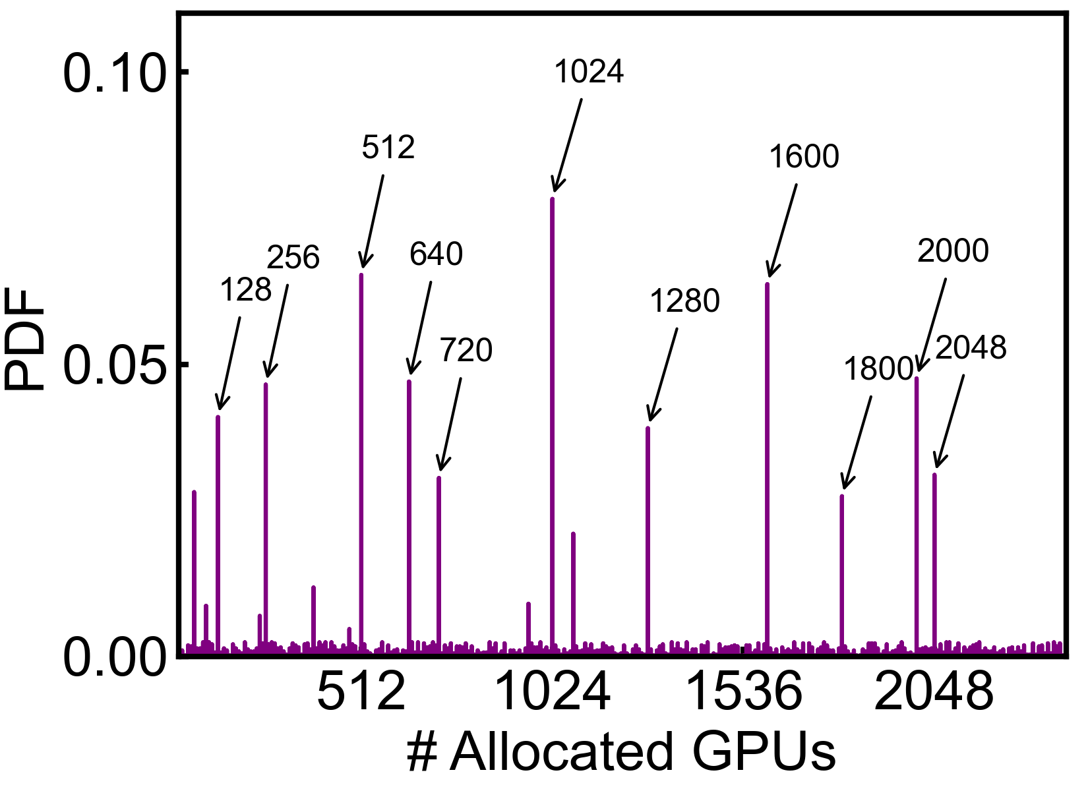
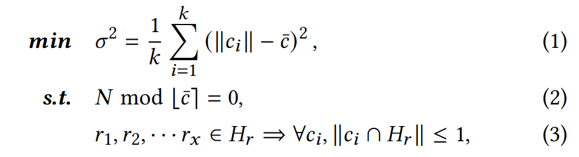
3. Design of SkeletonHunter
Traffic skeleton inference
  Runtime: Optimization with inferred traffic skeletons
Number of requested GPUs in a training job is confined to limited set of values (e.g., 128, 512, and 1,024)
Each DP group has the same number of RNICs
Degree of DP=TP·PP
DP Inference:
NVLink/PCIe Communications
Notes:
In order to make the clustering more accurate and interpretable, we add the following constrains to the clustering process.
First, the number of requested GPUs are only confined to a limited set of values.
So, we add the constrains like each DP group should have the same number of RNICs, and the multiplication of DP TP, and PP should be equal to the size of the training cluster.
Besides, each RNIC in the same host should belong to different DP group, since the intra-host GPU communications are handled by NVLink or PCIe link.

Slide 22
3. Design of SkeletonHunter
Traffic skeleton inference
  Runtime: Optimization with inferred traffic skeletons
t₀
t₁
t₂
t₃
t₄
t₅
t₆
t₇
PP Inference:
Time-shifted Send/Recv ( )
TP Inference:
No network activities for RNICs in the same host
No network activities among the RNICs of the same host
Notes:
In terms of PP, we infer their different levels based on the time-shifted send and receive activity among the RNICs.
And finally we can infer the TP groups where RNICs have no network activities for intra-host communications.

Slide 23
3. Design of SkeletonHunter
Traffic skeleton inference
  Runtime: Optimization with inferred traffic skeletons
~5% of the all-to-all ping list
Notes:
So in this way, we can infer which RNICs belong to which papalism group, and therefore recover the traffic skeletons for a large model training task.
We then remove the ping targets that are not in the traffic skeletons, and it further helps us reduce another 80% of ping lists.
We can eventually get the final ping list that is only around 5% of the original all-to-all ping list.

Slide 24
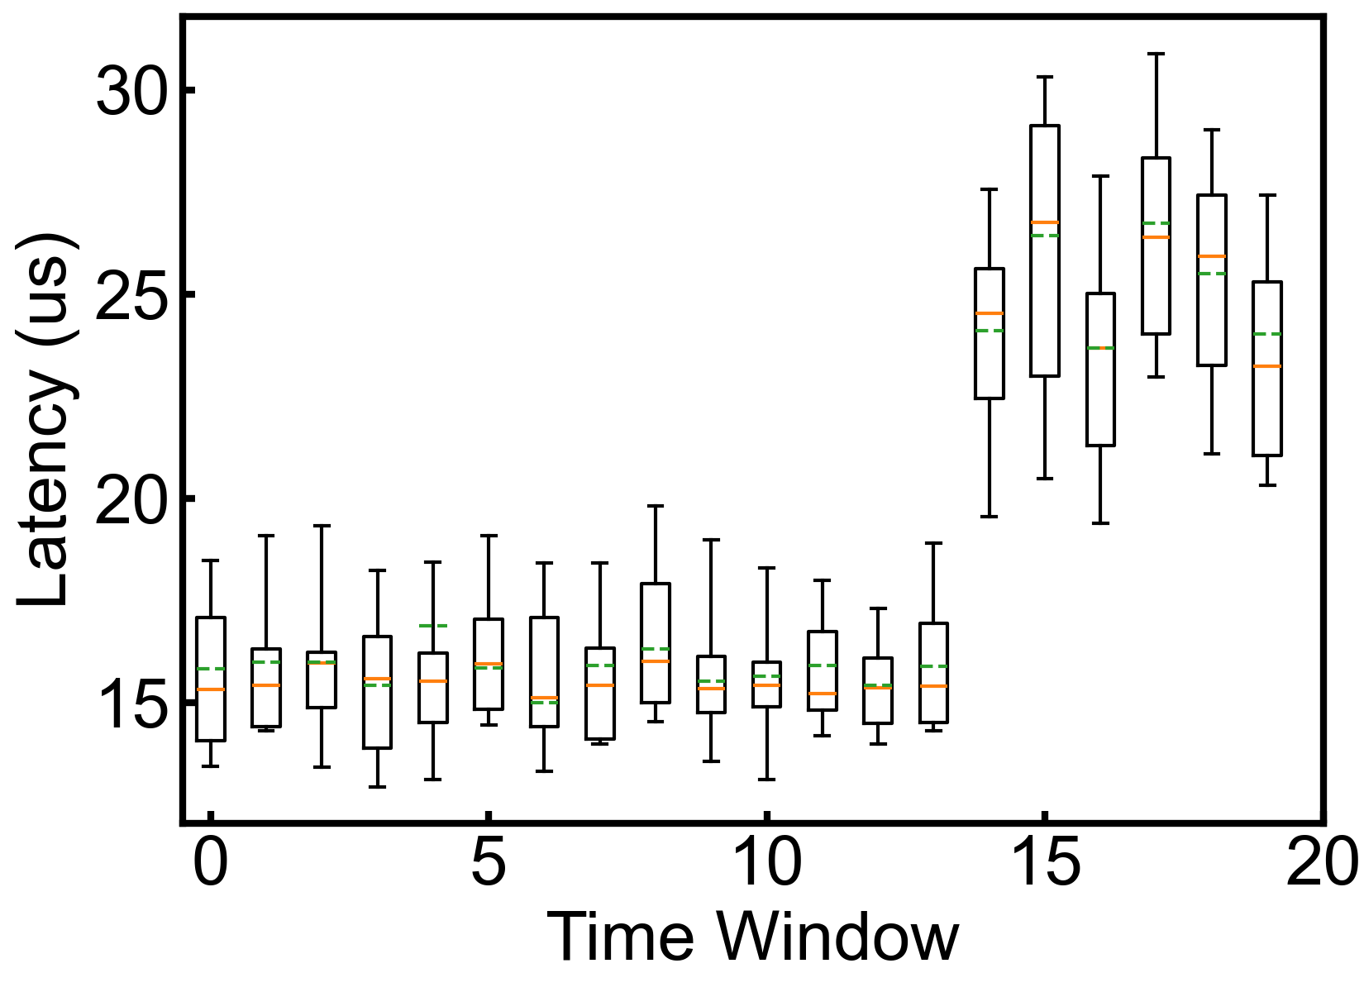
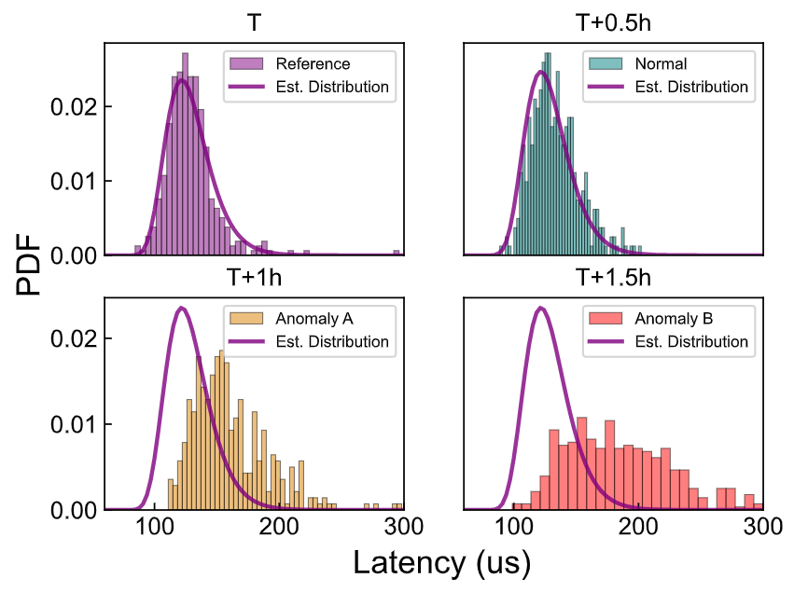
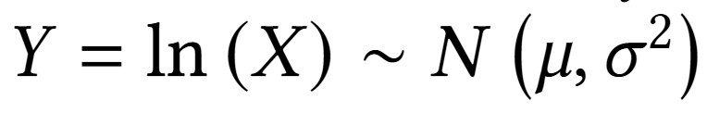
3. Design of SkeletonHunter
Connectivity anomaly detection
  Short-term
    Percentiles as a feature for time window comparisons
  Long-term
    Statistical testing to detect latency distribution changes
Notes:
After collecting the end-to-end latency data from the agent with the optimized ping list, we detect the connectivity anomaly from the data using a statistical method, including short-term and long-term detections.
Short-term detection uses a sliding window of 30 seconds and applies Local Outlier Factor (LOF) to latency percentiles for detecting latency changes
Long-term detection uses 30-minute windows and statistical tests against a log-normal distribution model to catch gradual degradations in end-to-end latency.

Slide 25

3. Design of SkeletonHunter
Network failure localization
  Optimistic assumption: the root causes of the overlay and the underlay layers are software- and hardware-related respectively, which will not propagate to the other layer
  Examine the two layers’ components separately
+1
+2
+3
Dump RNIC flow tables
+1
+1
+1
+1
+4
Underlay: Voting-based failure localization
Overlay: Flow table reachability test
Notes:
Once a connectivity failure or high latency is detected, we use optimistic disentanglement to localize it. Our key insight is that the root causes at overlay and underlay layers are usually software- and hardware-related respectively, which will not propagate to each other.
So they can be checked separately.
For the underlay, we leverage a voting-based failure localization scheme to vote for the links that are always lie between the connectivity failure endpoints.
For the overlay, we perform flow table reachability test to examine whether there is an error in the forwarding rules.
If both seem healthy, we fall back to manual inspection of RNIC flow tables.

Slide 26
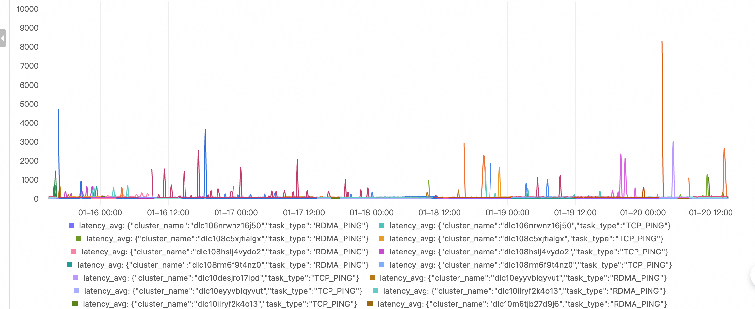
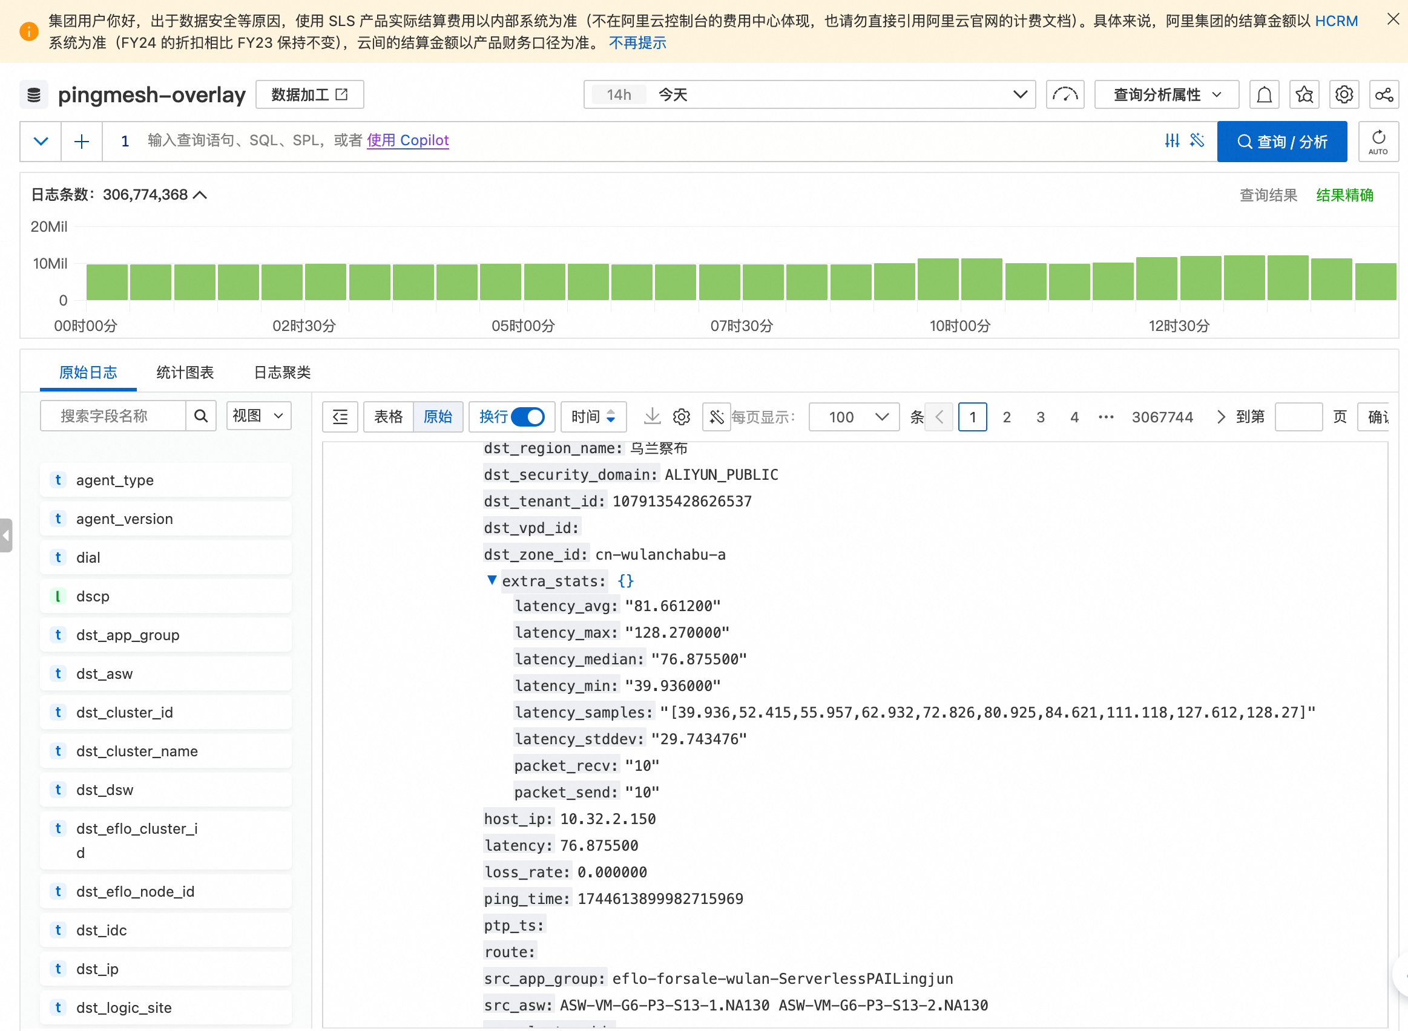
4. Evaluation
Real-world deployment
  SkeletonHunter has been deployed in Alibaba Cloud for a year
  Covering the containers on 5,700+ physical hosts and 40K+ RNICs
  1B latency logs among training containers every day
Notes:
SkeletonHunter has been running in production for over a year. It monitors over five thousand and seven hundred physical hosts and forty thousand RNICs. Every day, it collects and analyzes over 1 billion latency measurements, providing real-time visibility into network health.

Slide 27
4. Evaluation
Real-world deployment
  Detects and localizes 4,816 network failures with >98% accuracy
  Reduces 99% of failures after fixing corresponding network components
Notes:
SkeletonHunter has detected over four thousand network failures with a high accuracy. It correctly localized ninety five percent of them to specific faulty components. After fixing these, the monthly failure rate dropped by ninety nine percent.

Slide 28
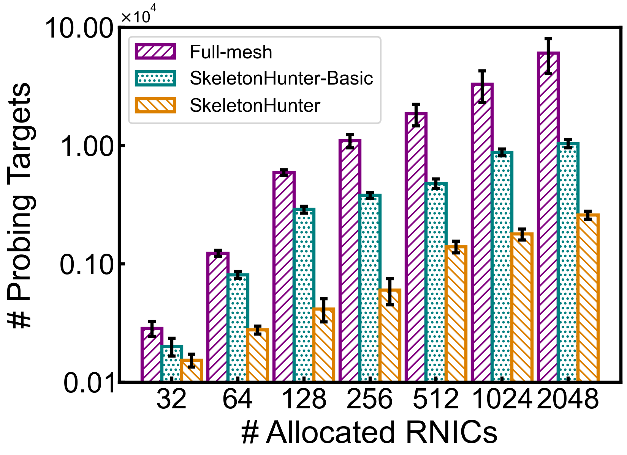
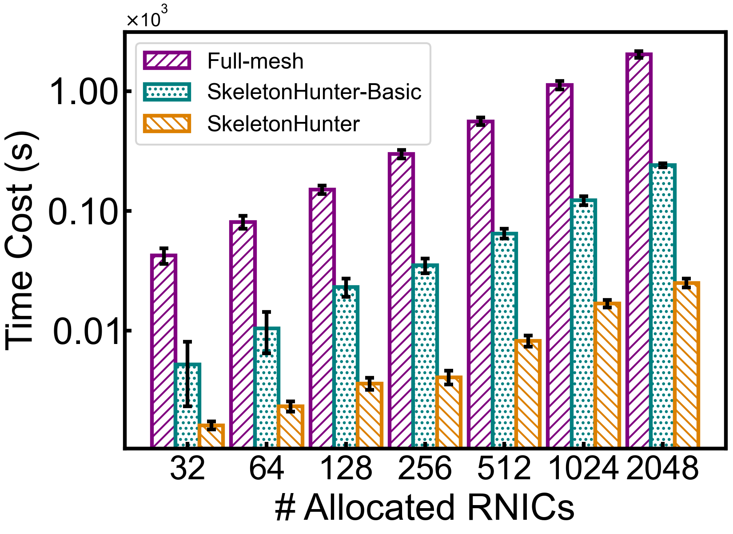
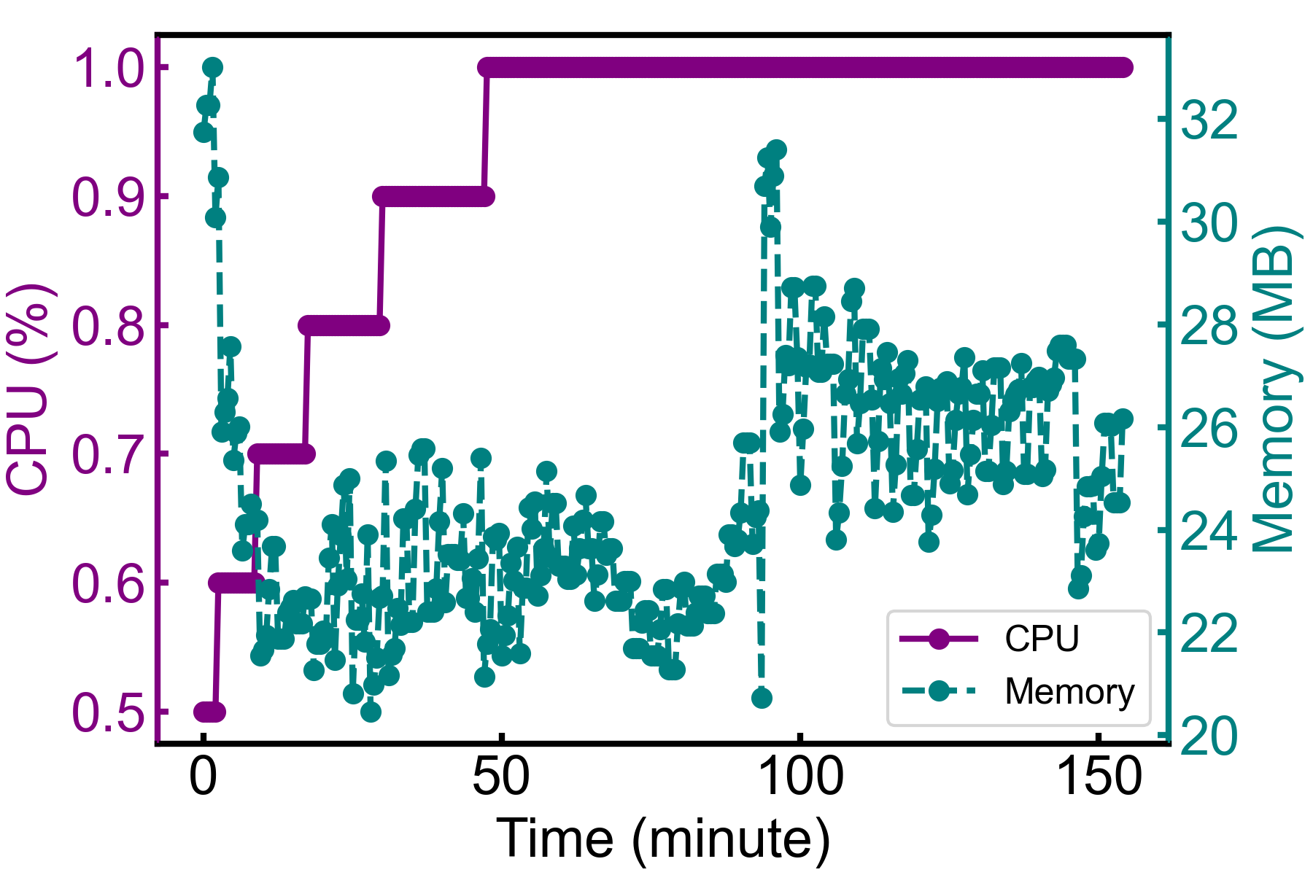
4. Evaluation
Real-world deployment
  Traffic skeletons help reduce detection complexity
  Negligible detection overheads: 8s for a probing round on average
Notes:
The design of inferring traffic skeletons significantly helps us reduce the detection complexity.
On average, SkeletonHunter can finish a probing round in eight seconds, which is much shorter than a training round for large models.

Slide 29
5. Conclusion
We are the first to point out the real-world challenges against reliable network support for large-scale containerized model training, as well as their multiplicative effect on troubleshooting the connectivity issues.
We propose SkeletonHunter, a container network monitoring and diagnosis system that leverages the unique traffic patterns of large model training to accurately and efficiently pinpoint the connectivity issues.
SkeletonHunter has been deployed in our production container network and has helped discover diverse network failures that derive from the problems of different network components. We have fixed most problematic network components and greatly reduced the monthly failure rate.
Thanks!
Q & A
Notes:
So let me conclude our work.
We are the first to point out the real-world challenges against reliable network support for large-scale containerized model training, as well as their multiplicative effect on troubleshooting the connectivity issues.
We propose SkeletonHunter, a container network monitoring and diagnosis system that leverages the unique traffic patterns of large model training to accurately and efficiently pinpoint the connectivity issues.
SkeletonHunter has been deployed in our production container network and has shown its efficacy in network failure detection and localization.
That’s all. Thanks for your attention, and I’m ready for Q and A.

